Slide 1
A joke
Paul tells: „we pray before eating.“
– Laura: „but we don't, our mother cooks very well.“

Slide 2
a tomato

Slide 3
a cucumber

Slide 4
a crucian carp

Slide 5
chocolate

Slide 6
salad

Slide 7
praline

Slide 8
fruits

Slide 9
vegetables

Slide 10
chicken

Slide 11
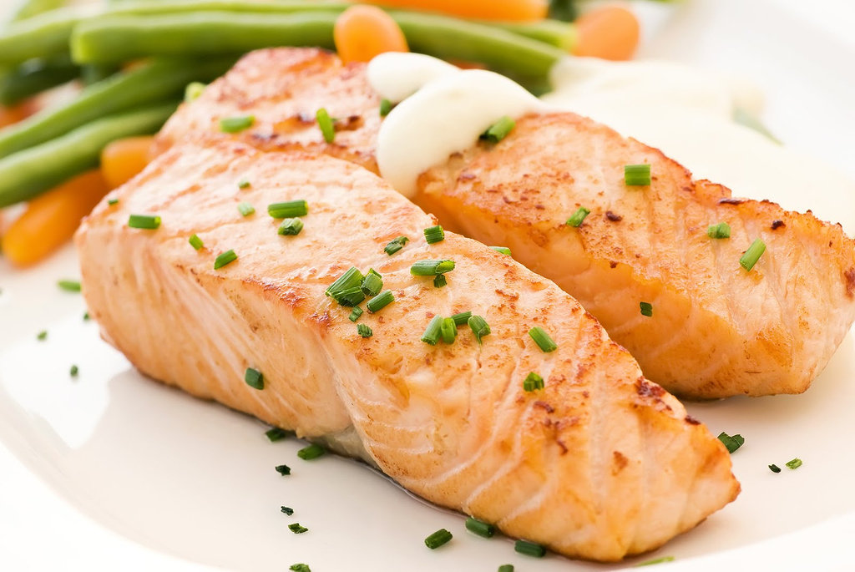
salmon

Slide 12
fish

Slide 13
a sausage

Slide 14
ham

Slide 15
butter

Slide 16
cheese

Slide 17
strawberry

Slide 18
an egg

Slide 19
cottage cheese

Slide 20
rice

Slide 21
noodle

Slide 22
bread

Slide 23
a banana

Slide 24
an apple

Slide 25
tea

Slide 26
milk

Slide 27
sause

Slide 28
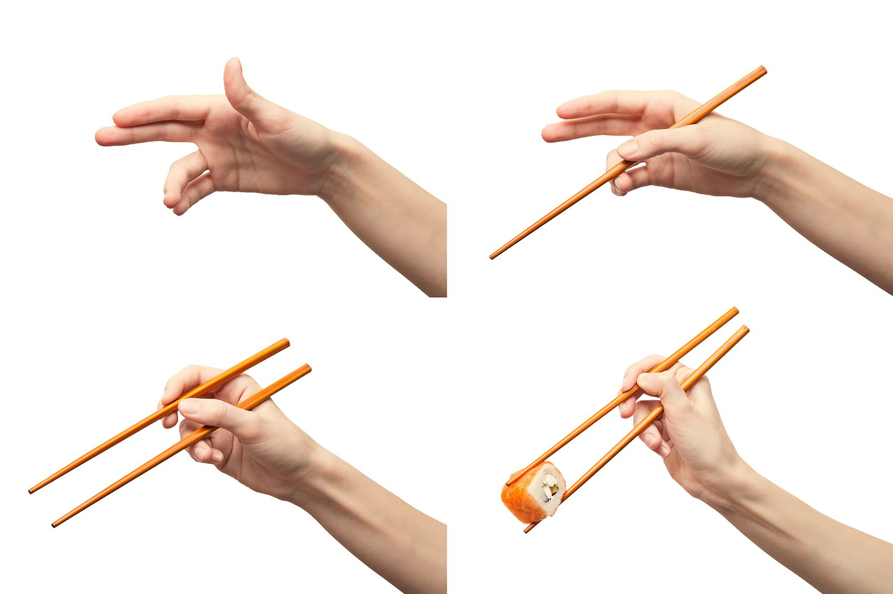
© Svetlana Gennadyevna F.

Slide 29
take …

Slide 30
Play with me!
Take the tomato.
Take the banana.

Slide 31
Play with me!
Take the bread.
Take the egg.

Slide 32
Play with me!
Take the noodle.
Take the apple.

Slide 33
Play with me!
Take the milk.
Take the cheese.

Slide 34
Play with me!
Take the strawberry.
Take the vegetables.

Slide 35
Play with me!
Take the praline.
Take the fruits.

Slide 36
Play with me!
Take the tea.
Take the vegetables.

Slide 37
Play with me!
Take the chicken.
Take the salad.

